Slide 1
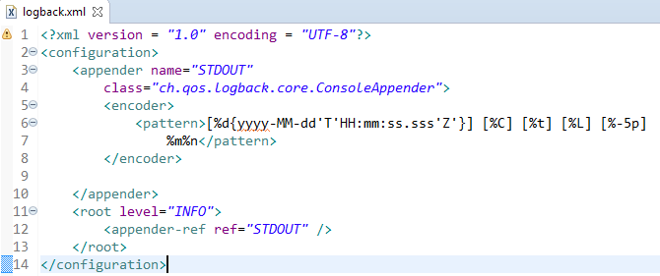
Spring Boot - Configure Logback
Logging configuration details are configured in logback.xml file. The logback.xml file should be placed under the classpath.

